Slide 1





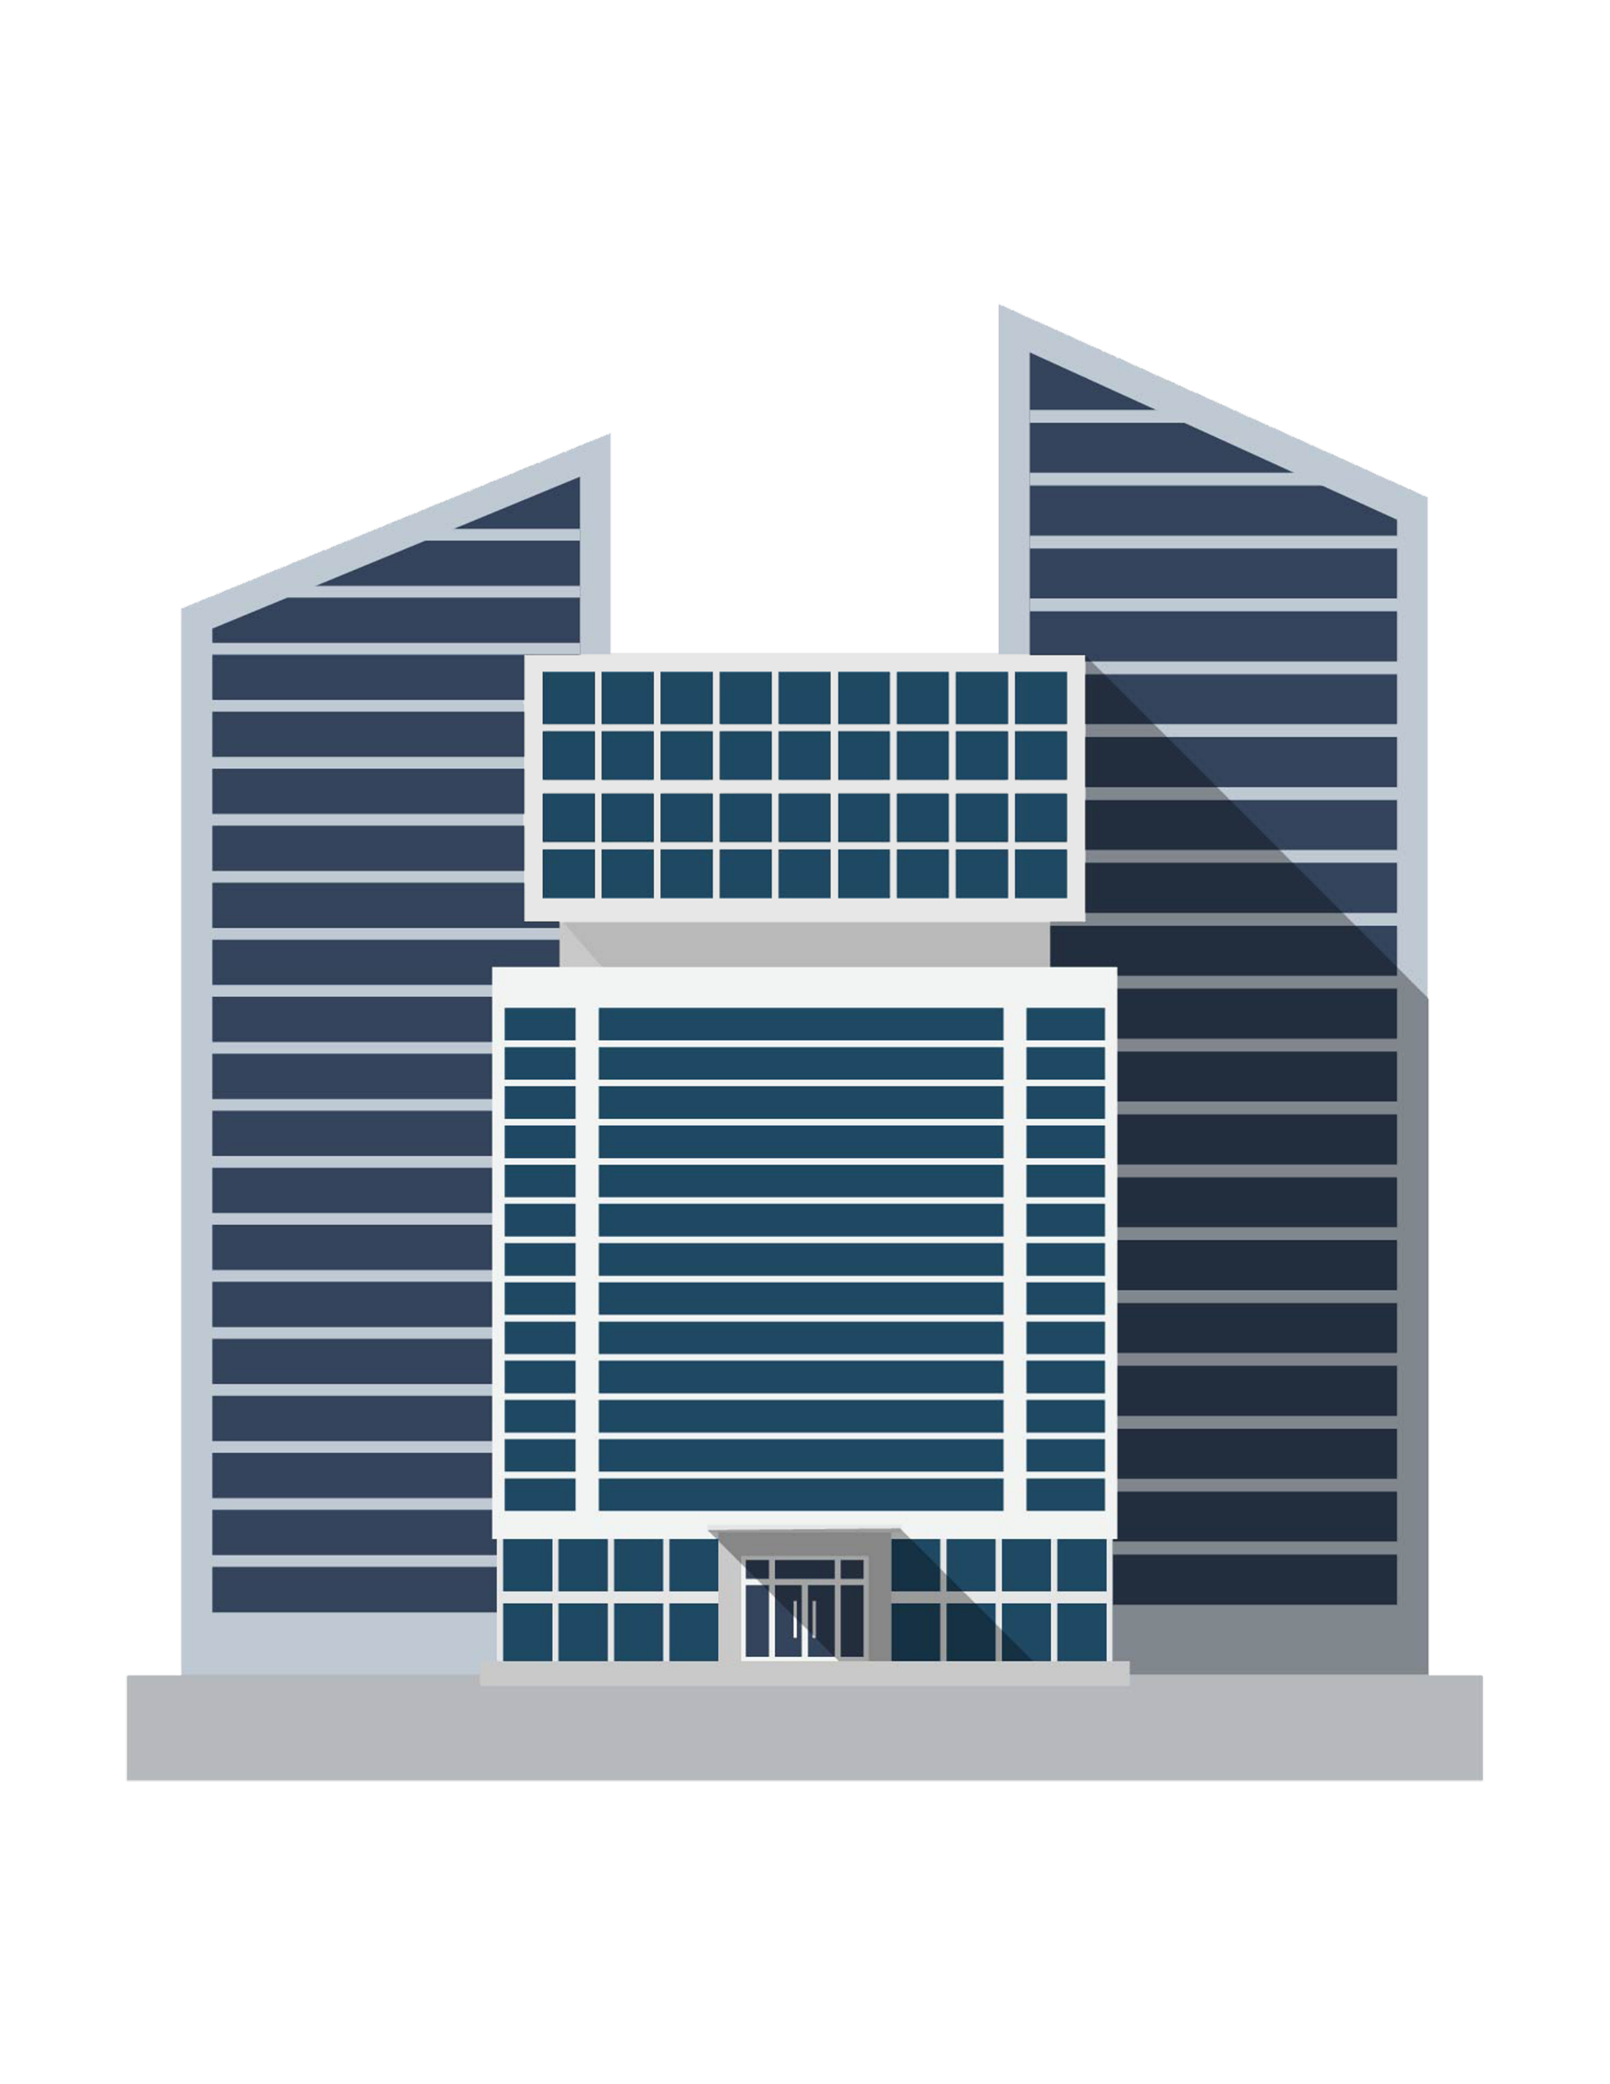











Here at NeoDocto, we provide a comfortable way for employees to work

Slide 2


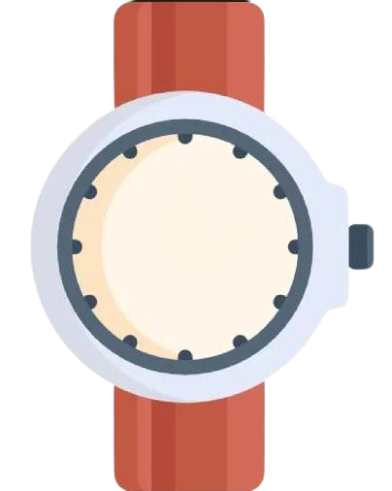


Fast Application and Approval, Flexible Hours, Kind Team Leaders and Mentors

Slide 3

Staff are great, they are accessible, kind, and responsive

Slide 4



They are considerate as well. Great place to improve skills without getting pressured.

Slide 5

















We treat you like an individual, not a worker.

Slide 6






The executives approach representatives, no workplace pressure and difficulties, just coordinated efforts and thoughts.

Slide 7


Workplace climate is friendly and it places where there is trust, cooperation, safety, risk-taking support, accountability, and equity.

Slide 8
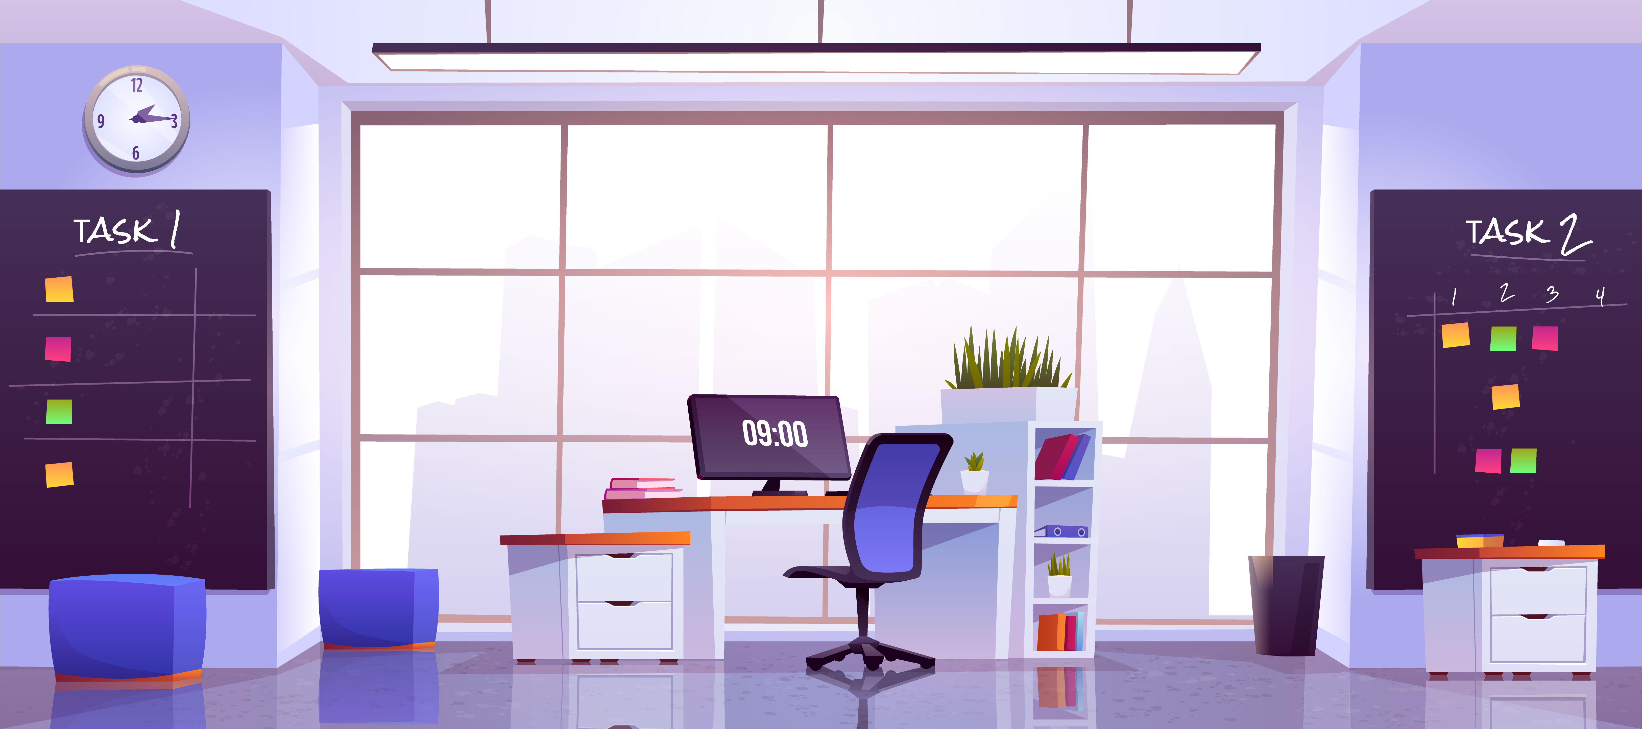
We take time to listen to our employees regarding their concerns and needs for performing their jobs. We try to Discuss various issues with employees, such as conflicts they may have with you or other employees.

Slide 9

Need an internship?
We got you here at

Slide 10
We got you here at
https://home.neodocto.com/

